Slide 1

Psychosocial hazards in the workplace

Slide 2
Psychosocial hazards
Psychosocial hazards are aspects of the work environment, management practices, workplace interactions and behaviours and the way work is organised which cause stress
Exposure to stress can cause psychological and physical harm
Psychological harm may include anxiety, depression, post-traumatic stress disorder, sleep disorders and more
Notes:
It’s important to understand what psychosocial hazards are, how they cause harm and what we can do to manage them.
Psychosocial hazards are aspects of the work environment, management practices, and the way work is organised which cause stress.
Exposure to stress can cause psychological or physical harm. Stress itself is not an injury. But if workers are stressed often, over a long time, or the level of stress is high, it can cause harm.
Psychological harm may include anxiety, depression, post-traumatic stress disorder, sleep disorders. So lets take a look at some examples of psychosocial hazards…

Slide 3



National data
$200-220 Billion
Australian Productivity Commission’s 2020 estimate of the cost of mental illness and suicide to the economy.
$67,500
The median cost of serious mental stress serious claims in 2021-22, almost 5 times greater than the median cost (approximately $16,000) of all serious claims.
38 weeks
The median time lost for serious mental stress claims.
5 times greater than the median for all serious claims
Notes:
It’s important to understand what psychosocial hazards are, how they cause harm and what we can do to manage them.
Psychosocial hazards are aspects of the work environment, management practices, and the way work is organised which cause stress.
Exposure to stress can cause psychological or physical harm. Stress itself is not an injury. But if workers are stressed often, over a long time, or the level of stress is high, it can cause harm.
Psychological harm may include anxiety, depression, post-traumatic stress disorder, sleep disorders. So lets take a look at some examples of psychosocial hazards…

Slide 4
Psychosocial legislation
Division 3.2.11 Psychosocial risks
55A Meaning of psychosocial hazard—div 3.2.11
For this division, a psychosocial hazard is a hazard that—
(a) arises from, or relates to—
(i) the design or management of work; or
(ii) a work environment; or
(iii) plant at a workplace; or
(iv) workplace interactions or behaviours; and
(b) may cause psychological harm (whether or not it may also cause physical harm).
55B Meaning of psychosocial risk—div 3.2.11
For this division, a psychosocial risk is a risk to the health or safety of a worker or other person arising from a psychosocial hazard.
55C Duty to manage psychosocial risk
A person conducting a business or undertaking must manage psychosocial risks in accordance with part 3.1 (Managing risks to health and safety).
Note WHS Act—s 19 (see s 9).
$200-220 Billion
$60,000
34 weeks
Notes:
It’s important to understand what psychosocial hazards are, how they cause harm and what we can do to manage them.
Psychosocial hazards are aspects of the work environment, management practices, and the way work is organised which cause stress.
Exposure to stress can cause psychological or physical harm. Stress itself is not an injury. But if workers are stressed often, over a long time, or the level of stress is high, it can cause harm.
Psychological harm may include anxiety, depression, post-traumatic stress disorder, sleep disorders. So lets take a look at some examples of psychosocial hazards…

Slide 5


Recognising Psychosocial hazards
Badly managed psychosocial hazards can lead to:
Bullying and harassment
Work-related violence
Sexual harassment
Work-related stress and psychological injury
$200-220 Billion
$60,000
34 weeks
Notes:
It’s important to understand what psychosocial hazards are, how they cause harm and what we can do to manage them.
Psychosocial hazards are aspects of the work environment, management practices, and the way work is organised which cause stress.
Exposure to stress can cause psychological or physical harm. Stress itself is not an injury. But if workers are stressed often, over a long time, or the level of stress is high, it can cause harm.
Psychological harm may include anxiety, depression, post-traumatic stress disorder, sleep disorders. So lets take a look at some examples of psychosocial hazards…

Slide 6
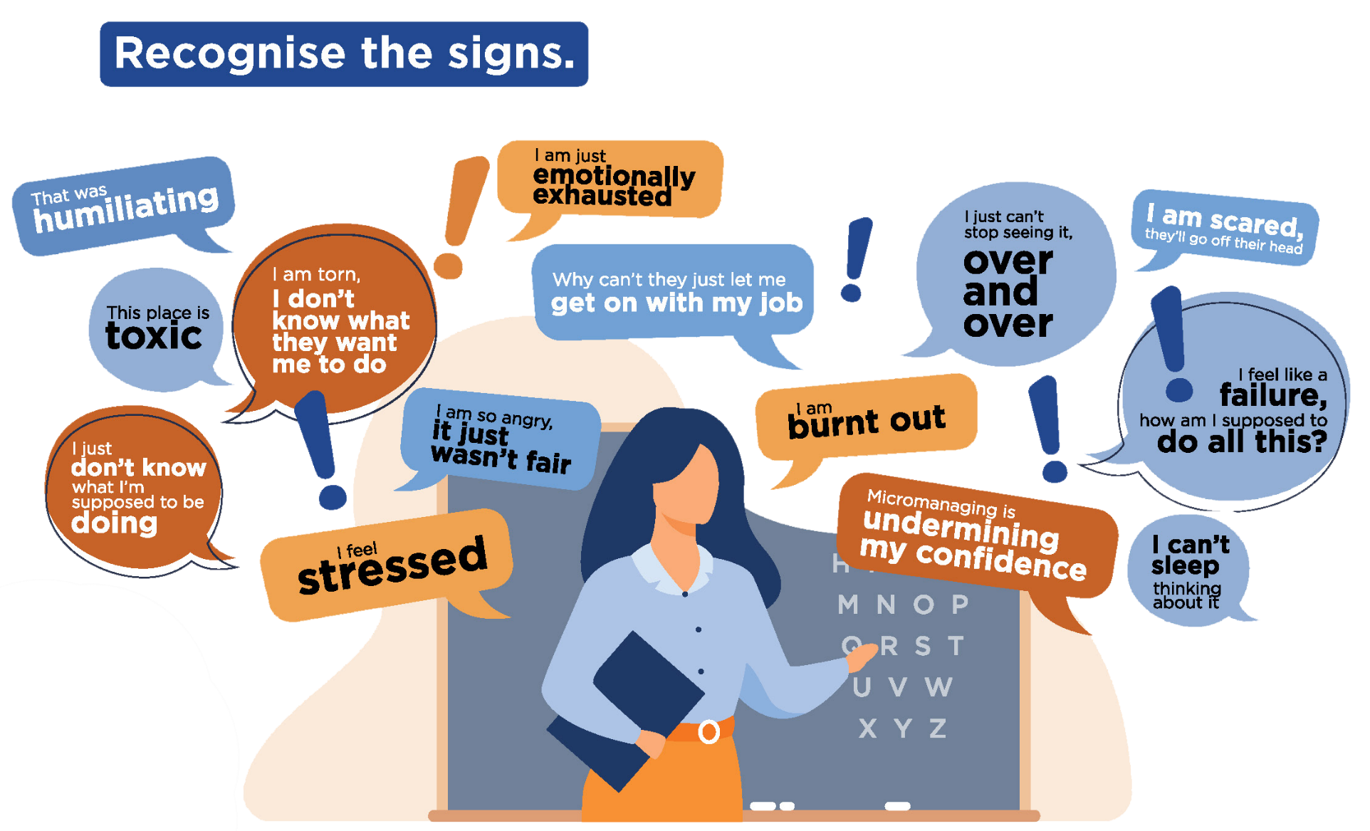
What psychosocial hazards sounds like
34 weeks
Notes:
It’s important to understand what psychosocial hazards are, how they cause harm and what we can do to manage them.
Psychosocial hazards are aspects of the work environment, management practices, and the way work is organised which cause stress.
Exposure to stress can cause psychological or physical harm. Stress itself is not an injury. But if workers are stressed often, over a long time, or the level of stress is high, it can cause harm.
Psychological harm may include anxiety, depression, post-traumatic stress disorder, sleep disorders. So lets take a look at some examples of psychosocial hazards…

Slide 7
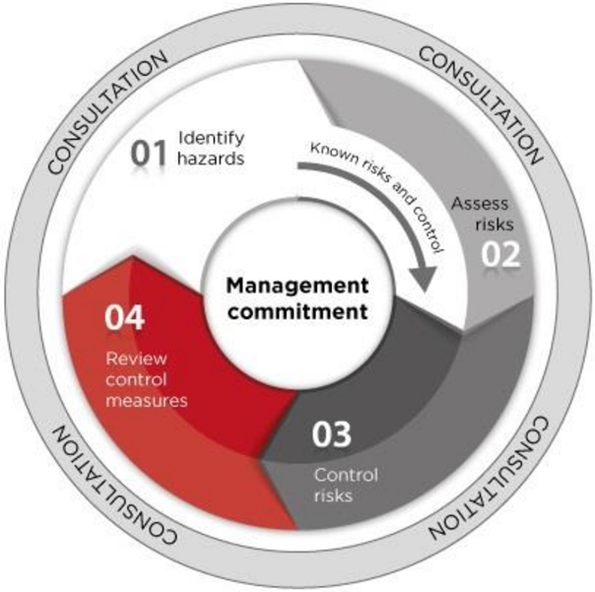
Risk management Process
STEP 1 – IDENTIFY THE HAZARDS
Find out what could cause harm
STEP 2 – ASSESS RISKS
Understand the harm that could be caused, how serious the harm could be and the likelihood of it happening
STEP 3 – CONTOL RISKS
Implement control measures and ensure they remain effective over time
STEP 4- REVIEW HAZARDS AND CONTROL MEASURES
Ensure control measures are working as planned
Source: SWA 2018 model Code of Practice: How to manage work health and safety risks

Slide 8
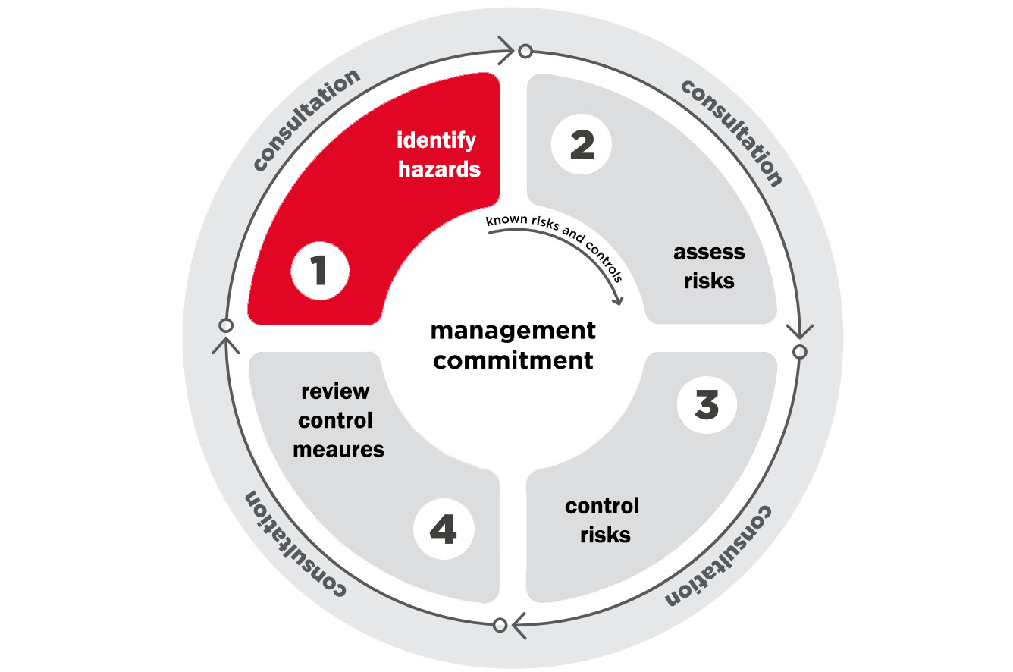
Identifying hazards
1
Visible and physical hazards:
  lifting heavy or unstable loads, such as unloading stock
  slips, trips and falls, such as slipping on a wet floor
  hazardous chemicals, such as cleaning chemicals
  loud noises, such as loud music
Psychosocial hazards:
  extremely high job demands
  emotionally challenging work
  complex and high consequence tasks
  violence and aggression
  working with members of the public
How to identify hazards:
  consult with workers
  use surveys for anonymity
  observe the work environment
  look for information and trends
  encourage formal reporting

Slide 9
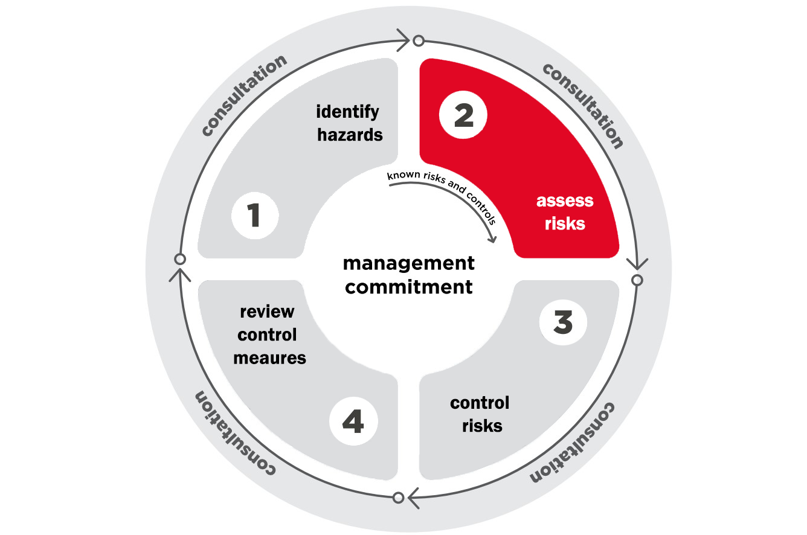
2
Assessing risks
Mental health is not a fixed state of mind
Responses to psychosocial risks are not as predictable
as for physical risks
Assessing psychosocial risks
Duration: How long are workers exposed to
the hazard?
Frequency: How often are workers exposed?
Severity: How severe is the exposure?
What is the impact of all of these combined?

Slide 10
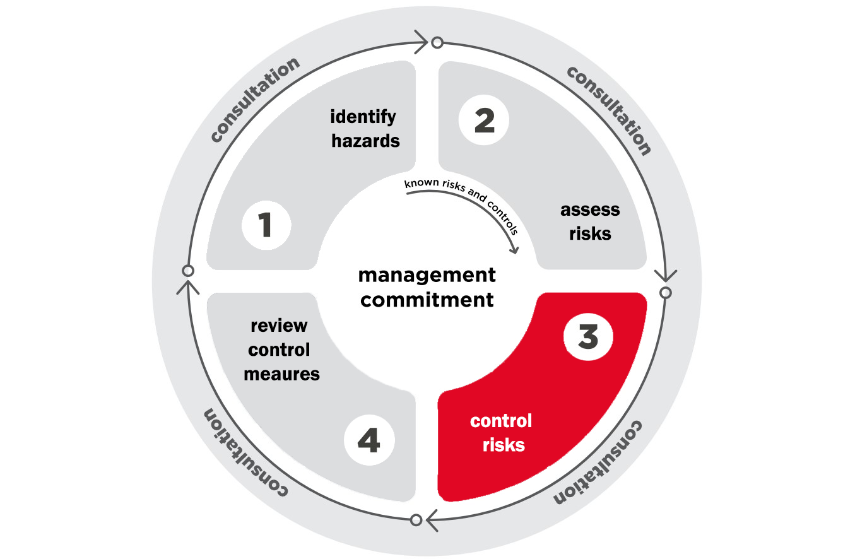
Controlling risks
3
What can affect what is ‘reasonably practicable’
the severity of any injury or harm to health that may occur
the likelihood of the injury or harm occurring
how much is known about the hazard and the ways of
reducing, removing or controlling it
the availability and suitability of ways to eliminate or
minimise the risk
what the duty holder knows or ought reasonably to know
about the hazard giving rise to the risk and ways of
eliminating or minimising the risk
the cost of eliminating or minimising the risk, and
anything else prescribed by regulation.

Slide 11

Controlling risks continued
Controls for common physical risks include:
assisted lifting machinery
correct labelling and storage on chemicals
providing personal protective equipment (PPE)
Controls for psychosocial risks include:
Planning work to ensure complex tasks are given
adequate time
altering the work environment
  providing workers with areas that are secluded from
  customers and the public
  screens as barriers for workers to protect them from
  violence and aggression
providing easily accessible reporting procedures and support services should incidents occur

Slide 12
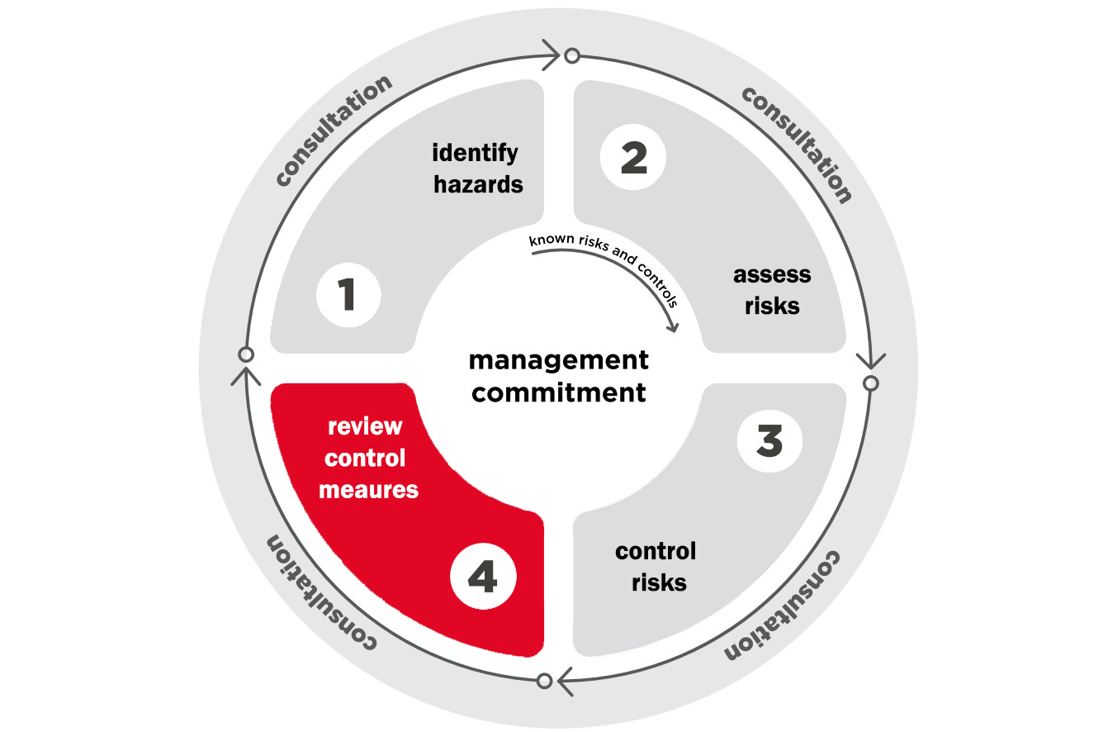
Reviewing and monitoring risks
4
How to review and monitor psychosocial risks:
Consult with workers about the control measures
Repeat surveys
Observe the workplace, and
Review the relevant data:
  unplanned absence patterns
  workers’ compensation claims
incident and grievance reports

Slide 13
Reviewing and monitoring risks continued
Positive indicators look like:
Less incident reports and complaints
Reduction in psychosocial illness and injury
Improved morale, resilience and engagement
Less reliance on PPE
Negative indicators look like:
Increase or no change to number of incident
reports and complaints
Increased time needed to recover
Worker resignations

Slide 14
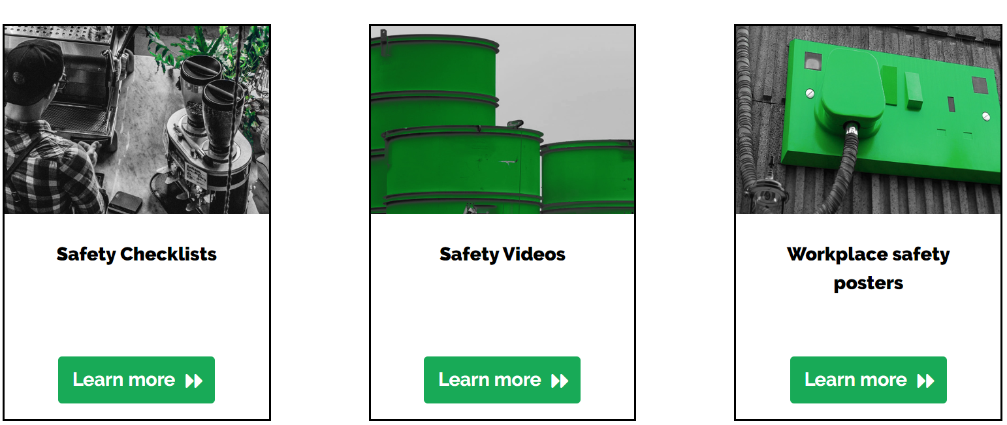
safety RESOURCES

Slide 15
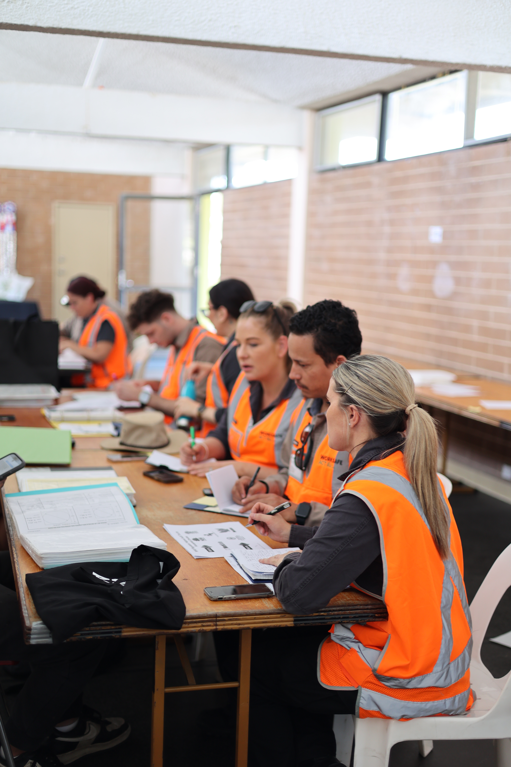
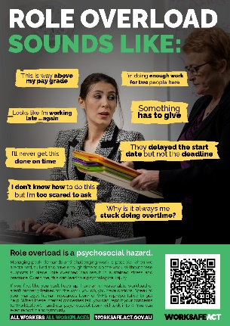
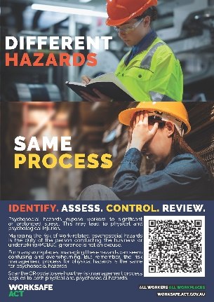
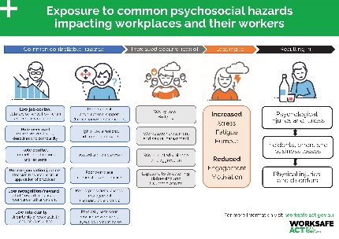

QUESTIONS & THANKS
See our website for psychosocial workplace resources
WWW.WORKSAFE.ACT.GOV.AU
FOLLOW US ON LINKEDIN
And FACEBOOK

